Slide 1
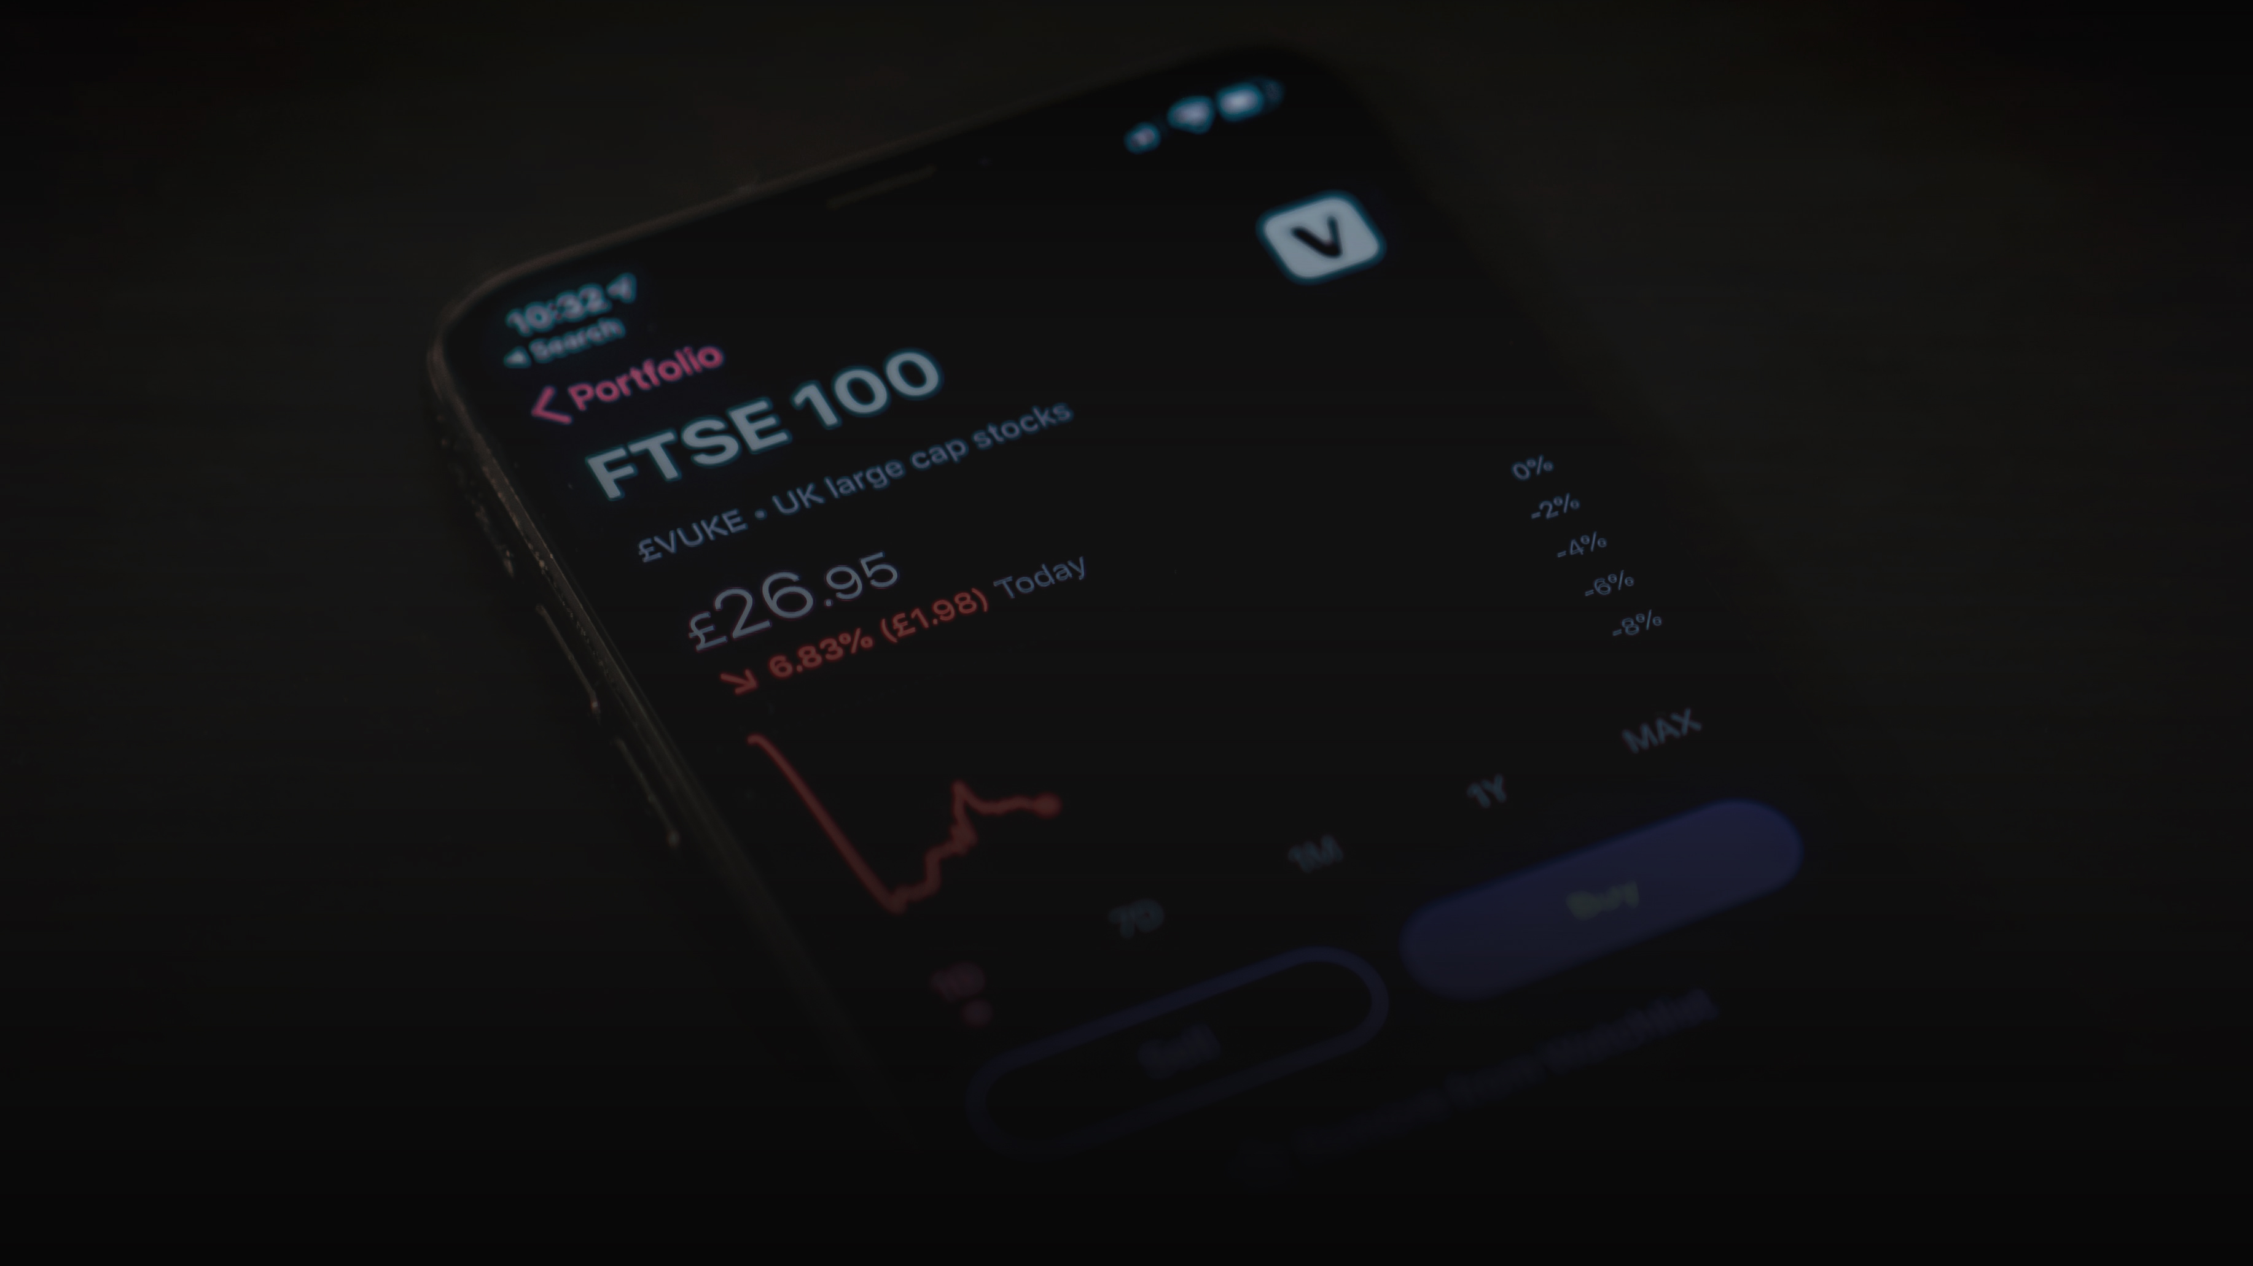

MAVAL

Slide 2


Our Team
Ngo Thanh Van
Nguyen Tung Lam
Nguyen Tuan Minh
Nguyen Truong An
Nguyen Phuong Ha
Front-end Developer
SIS Year 3
Major in Cybersecurity
UI/UX Designer
SOE Year 2
Major in Economics
Back-end Developer
SIS Year 3
Major in Business Analytics
Back-end Developer
SIS Year 3
Major in Business Analytics
Business Developer
SOB Year 2
Major in Finance

Slide 3
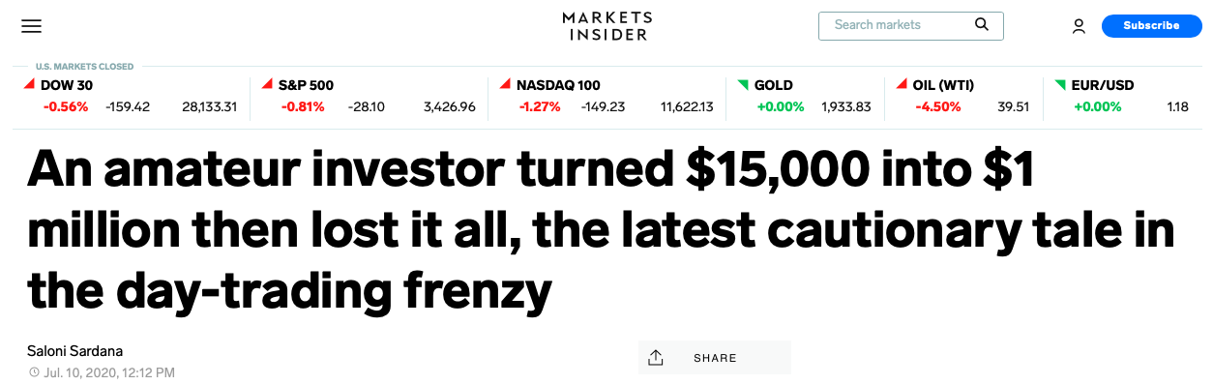

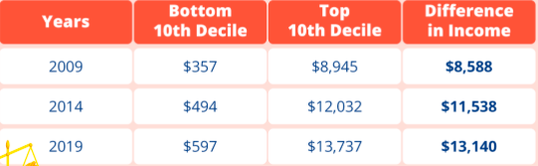



What we are solving
INDUSTRIAL BUILDINGS
Knowledge
OUR VISION
Lack of financial knowledge
Individuals
1
Engage in risky trades
47% of Singaporeans understand the need for risk diversification¹
They risk losing money because they do not understand their investments.
Source: Business Insider, 2020
Too much information/noise
Markets
Liquidity flywheel & Correction
Retail option trader
TSLA, APPLE
Brokerage House
2
There are too many news outlets from newspaper, blogs, research, reports.
Easy access to option trading for novice traders may drive market volatility.
Inability to find suitable products
Society
Wealth inequality
3
There is a lack of products that are catered to novice traders.
People with a diversified portfolio weather the adverse effects of COVID-19 better.
Source: Department of Statistics, 2019
Experience
Exposure
We hope to equip users with a well-rounded understanding about the financial market and financial products.
We hope to bring a safe environment for users to apply their knowledge and improve themselves.
We offer users exposure to as many asset classes as possible, that are suitable for a retail investors.

Slide 4
Key Features
Our product
Our vision
Portfolio recommendation with many asset classes based on financial background and risk tolerance
Experience
Selected briefing categorized in macro, industry and company news for your portfolio every morning
Exposure
Trial investments for all asset classes with real-time price quote and market movements
Knowledge

Slide 5













Our Technology
External APIs
Framework
Backend
Database
Frontend

Slide 6
FREE
PREMIUM – S$100
Business Model
We target the youth from 15 to 30 years old
Asset classes
In recommendation
2
(stocks and bonds)
4
(stocks, bonds, REIT, ETF)
Access to information
News classified to macro, industry & company*
Categorized news, sell-side reports, letters to investors of funds*
Knowledge hub
Infographic explanation of basic finance concepts
Interactive learning with companies’ financial statements
Unbundle options
($30/asset class)
All services in premium for a particular asset class
(*): Information for investments in the portfolio only

Slide 7








Competitors
We believe our web offers the most holistic experience
WM* platforms
by banks
Robo Advisory
Trading platforms
MAVAL
Examples
MAVAL
Suitable for those with bank accounts in Singapore
Only for taxpayers in Singapore
Only for those interested in the US market
Available for 15 years old and above residing anywhere in the world
Accessibility
Commission fee on all trades (0.12%) + SGX trading fee
0.5% - 0.8% of total investment (management fee)
On a per share basis
($0.0000019/share
for equity)
Subscription and unbundle options allow for more flexibility
Fee
- Analyst reports available
- No explanation of concepts
- No in-house research
- Too brief explanation of concepts
- No in-house research
- Too brief explanation of concepts
- No in-house research
- Interactive explanation of concepts
Knowledge hub
(*) WM: Wealth Management

Slide 8
Business plan
2021
2023
Launch to the whole Singapore
Expand to the Vietnam’s market
2020
2022
2024
Trial at SMU and refine the product’s features
Launch a new premium plan which also includes structured products, unit trust
Develop a community for people to share their trading ideas
Monthly Active Users
( in millions)
Projected Revenue
( in thousands)
25% yoy growth rate
40% yoy growth rate
70% of revenue comes from the premium option
30% of revenue comes from the unbundle option
Assumption:
2020: 5% monthly churn rate & 25% growth rate
2021 – 2024: 25% year-on-year growth rate
Assumption:
2020: 2% conversion rate
2021 – 2024: 5% conversion rate

